Slide 1

Tutorial: Geometry Pre-Processing
Eneko Lazpita
ModelFLOWs
Cardiac

Slide 2


Prerequisites:
Matlab with STL management packages.
Open Source software: 3D Slicer, MeshLab, Paraview
CAD Creation Software
CT scan medical data
ModelFLOWs
Cardiac

Slide 3
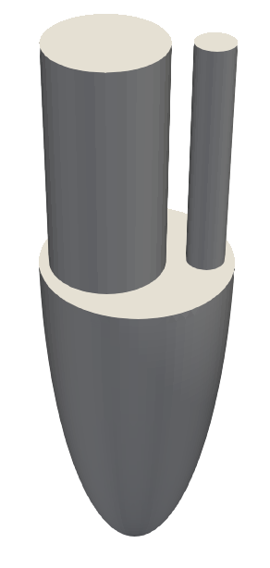






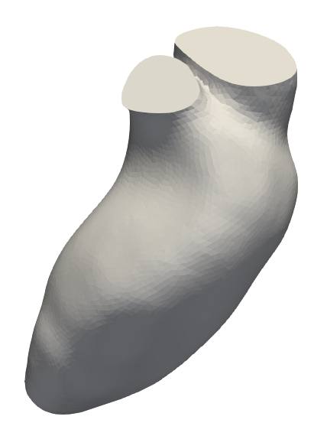
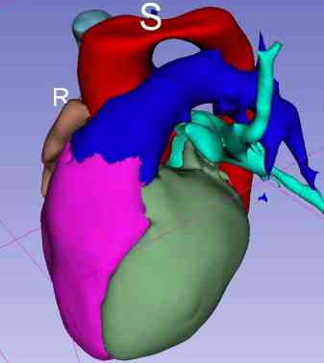
Ideal
If evolution files available
Construction
Patient Specific
STL Generator
Meshing
If evolution files available
Simulation
Segmentation
ModelFLOWs
Cardiac
Introduction

Slide 4
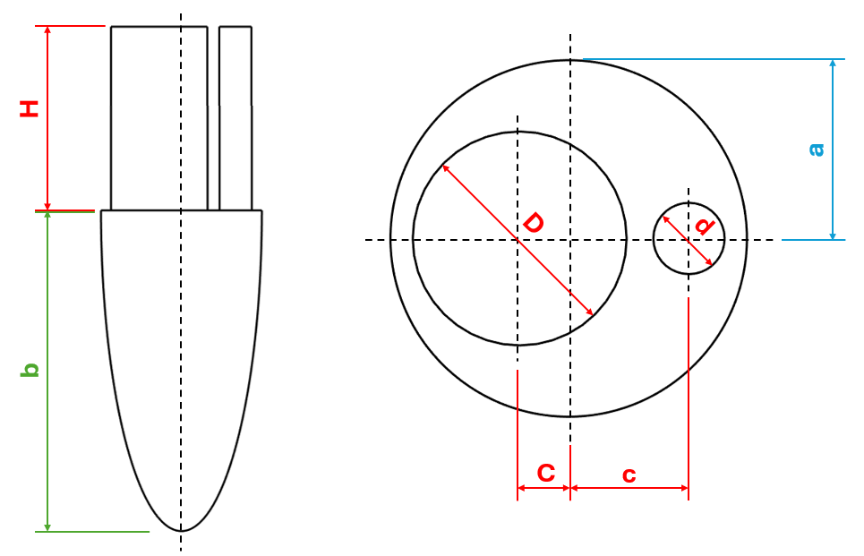
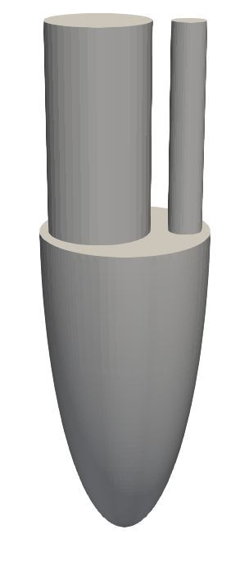
Starting Geometry
a: | 2.00 cm | D: | 2.40 cm | C: | 0.55 cm
b: | 8.00 cm | d: | 0.40 cm | c: | 1.35 cm
H: | 4.80 cm
Zheng et al., 2012. Computational modeling and analysis of intracardiac flows in simple models of the left ventricle.
ModelFLOWs
Cardiac
Ideal

Slide 5
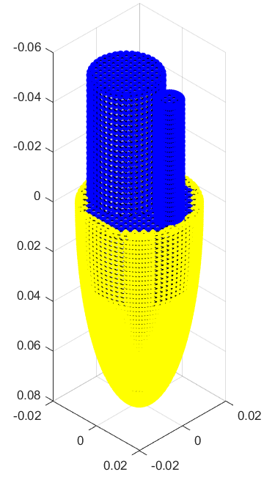
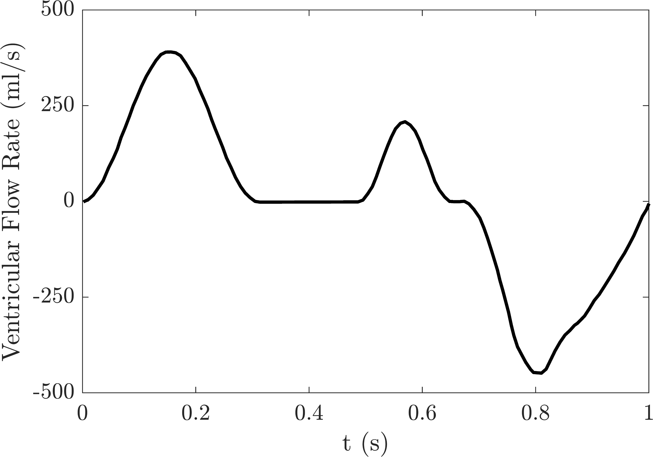
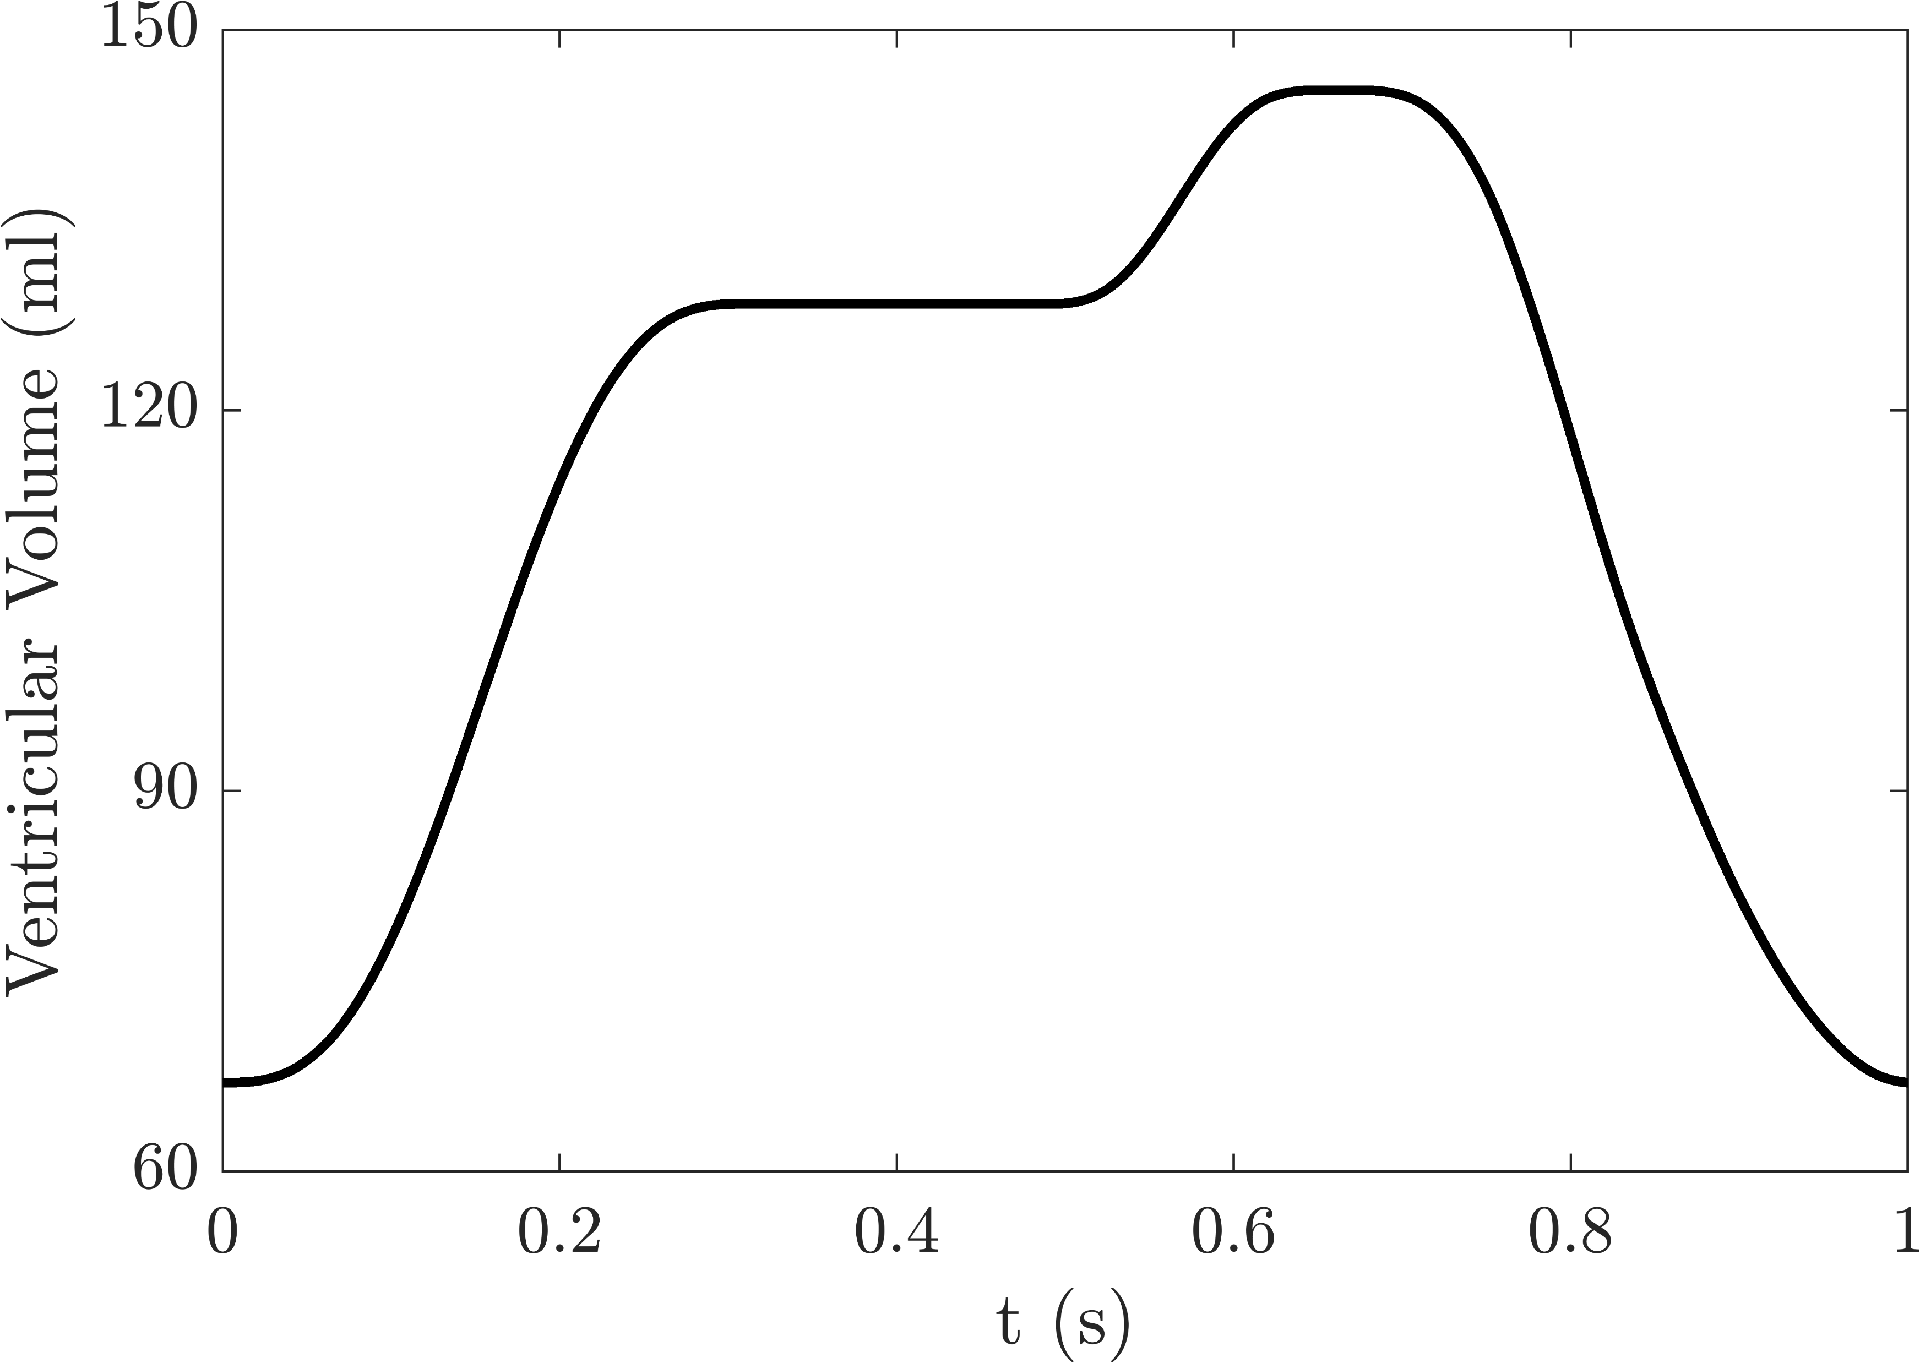
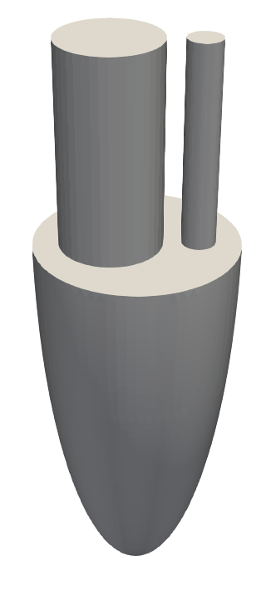
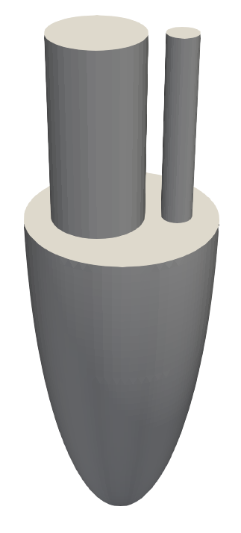
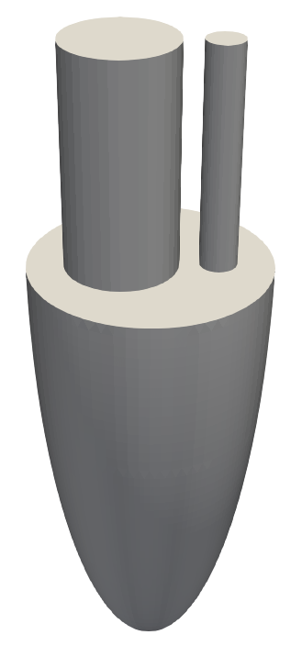
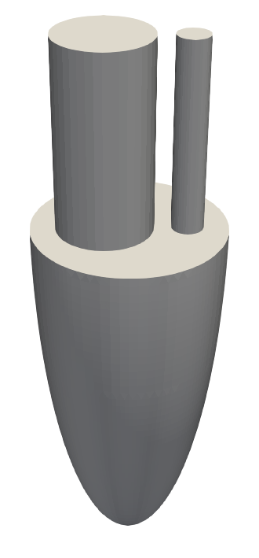

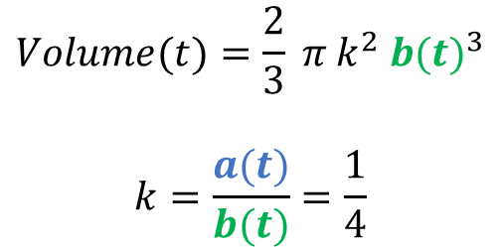
Point Classification
Integration
2
3
1
4
$$\int{fR dV }$$
1
2
3
4
$$Volume(t)={\frac{2}{3} π{ k}^{2} b(t)}^{3}$$
$$k=\frac{a(t)}{b(t)}=\frac{1}{4}$$
STL Generation
ModelFLOWs
Cardiac
Ideal

Slide 6
3. Process Flow Rate Data
1. Load Geometry
2. Classify Vertices
Read flow rate data
Interpolate flow rate data
Adjust flow rates to correct volume differences between systole and diastole.
Read STL file
Scale & extract point and connectivity data
Detect and categorize vertices based on geometric conditions
5. Generate STL Files
4. Calculate Volume Variations
6. Prepare Inlet and Outlet Data
For each time step:
Calculate scaling factors for the ventricle's dimensions.
Apply displacements to shell & base points based on scaling.
Write new geometry to STL file.
Define time steps for STL generation.
Compute volume variations by integrating flow rate chart.
Derive inlet velocities and outlet flow rates from flow data.
Write results to CSV files.
ModelFLOWs
Cardiac
Ideal

Slide 7
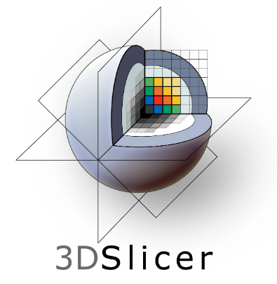


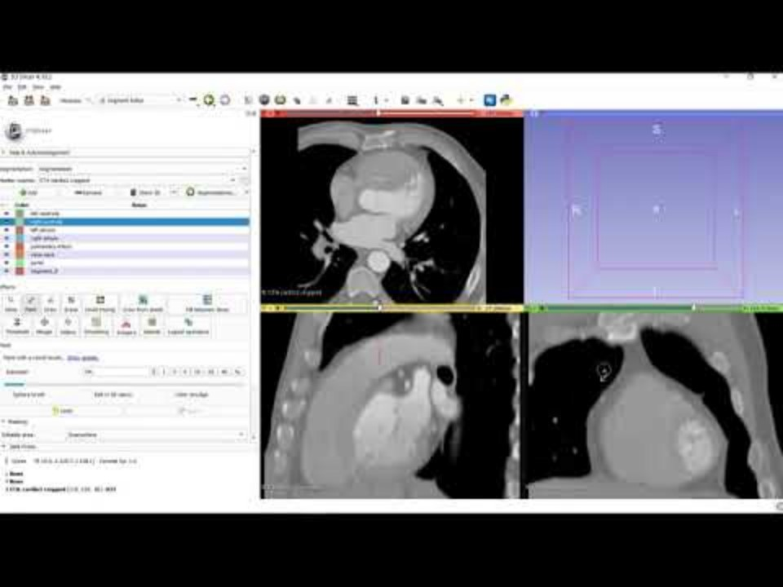
Segmentation
Pre-Processing
Starting Geometry
MeshLab
ParaView
ModelFLOWs
Cardiac
Patient Specific

Slide 8
3D Slicer:
File → Add Data → Choose File(s) to Add → Select your data
Modules → Converters → Crop Volume:
Fix
Check Isotropic spacing
Spacing scale: 3.00x
Apply
Check off Display ROI
Modules → Segmentation → Segment Editor:
Add: Left Ventricle (we will include aorta & left atrium here), Others
Paint: Mark seeds in each cavity
Grow From Seeds: Initialize and Apply
Click in green arrow “Go to segmentation module”: Create Closed Surface
ModelFLOWs
Cardiac
Patient Specific

Slide 9
3D Slicer:
3D View (top right panel) → Button of Center View
Fix surface in 3D View: Modules → Segmentation → Segment Editor:
Paint: Check “Edit 3D” → Fill holes
Smoothing → Joint smoothing → Apply
Modules → Informatics → Data:
Right click in Left Ventricle → Export visible segments to models
Right click in the model created → Export File → Select File Name, Directory and STL format
ModelFLOWs
Cardiac
Patient Specific

Slide 10
MeshLab:
File → Import Mesh → Load STL file
Filters → Cleaning and Repairing → Remove Isolated Pieces (wrt Diameter):
Select the measure percentage: 25.00%
Apply
Edit → Select Faces in a rectangular region → Select Aorta & Left Atrium
Filters → Selection → Delete Selected Faces
Filters → Cleaning and Repairing → Remove Isolated Pieces (wrt Diameter)
Filters → Remeshing, Simplification and Reconstruction:
Close Holes → Max size to be closed = 1000 → Apply until output is 0 holes
Remeshing: Isotropic Explicit Remeshing: Apply until smooth mesh
File → Export Mesh As: Save edited STL file
ModelFLOWs
Cardiac
Patient Specific

Slide 11
ParaView:
File → Open → Load STL file
Filters → Alphabetical→ Transform:
Scale: 0.001 in all directions to have the ventricle in meters
Rotate: Adjust orientation so z-axis is the vertical direction
Translate: Position the ventricle centered in origin → Use “Source → Plane” as guide
File → Save Data → Save edited STL file
ModelFLOWs
Cardiac
Patient Specific

Slide 12
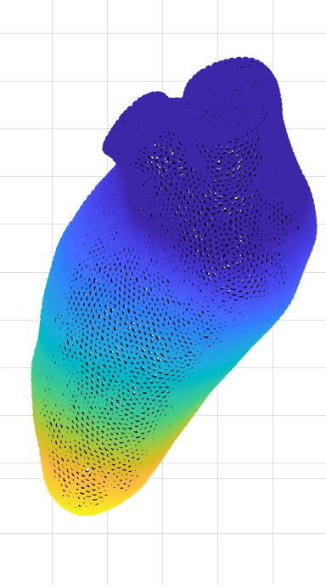
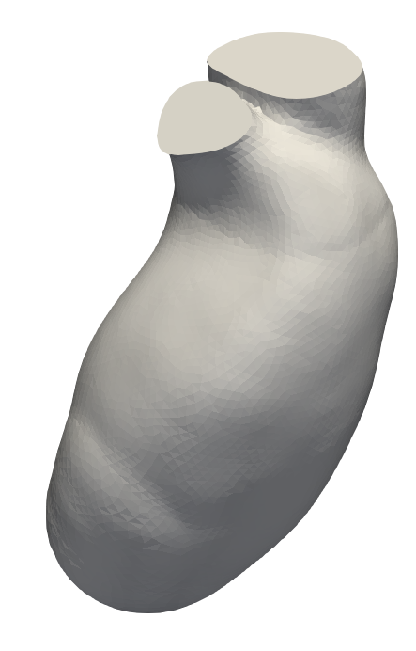
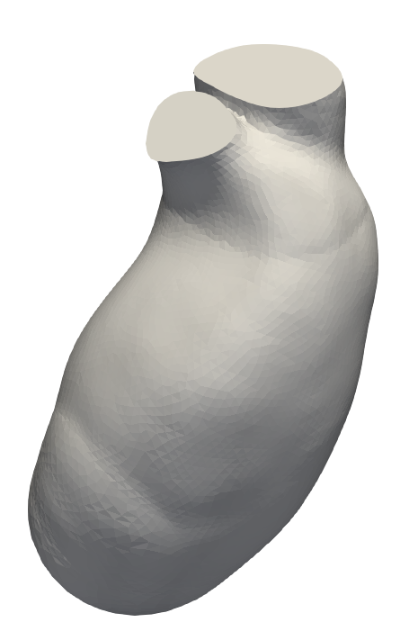
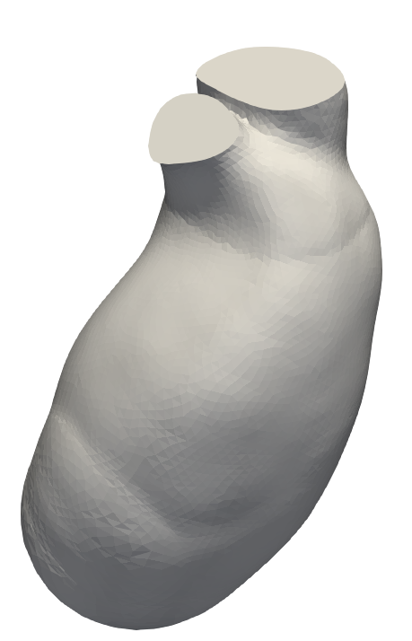
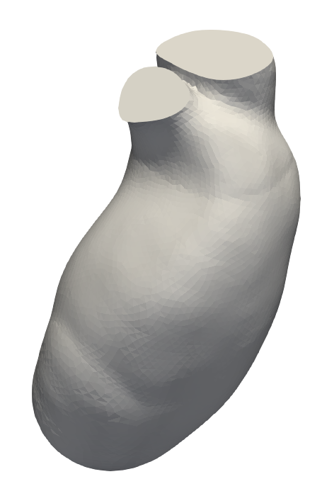
Point Classification
Integration
2
3
1
4
1
2
3
4
More displacement when close to apex.
Iterative algorithm to fit volume.
Displacement following normal of elements.
STL Generation
ModelFLOWs
Cardiac
Patient Specific

Slide 13
1. Load Geometry
3. Process Flow Rate Data
Read STL file
Scale & extract point and connectivity data
Compute initial volume and face normals.
2. Classify Vertices
Read flow rate data
Interpolate flow rate data
Adjust flow rates to correct volume differences between systole and diastole.
Detect and categorize vertices based on geometric conditions
5. Generate STL Files
4. Calculate Volume Variations
For each time step:
Calculate scaling factors for the ventricle's dimensions.
Adjust vertex displacements iteratively to match target volumes.
Write new geometry to STL file.
6. Prepare Inlet and Outlet Data
Define time steps for STL generation (nS).
Compute volume variations by integrating flow rate chart.
Derive inlet velocities and outlet flow rates from flow data.
Write results to CSV files.
ModelFLOWs
Cardiac
Patient Specific

Slide 14
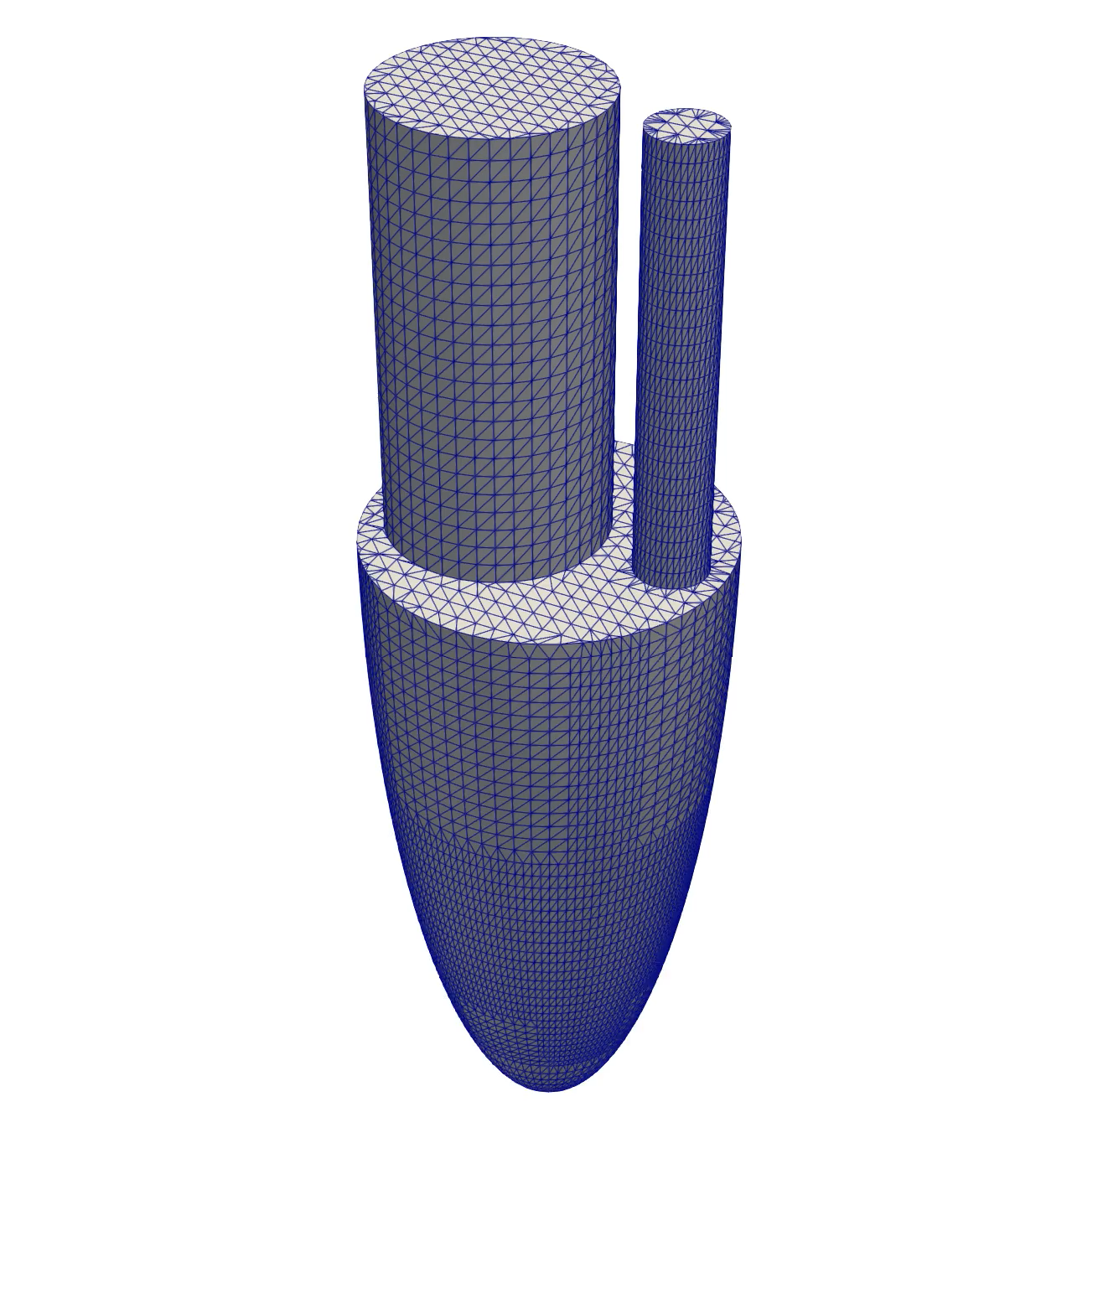
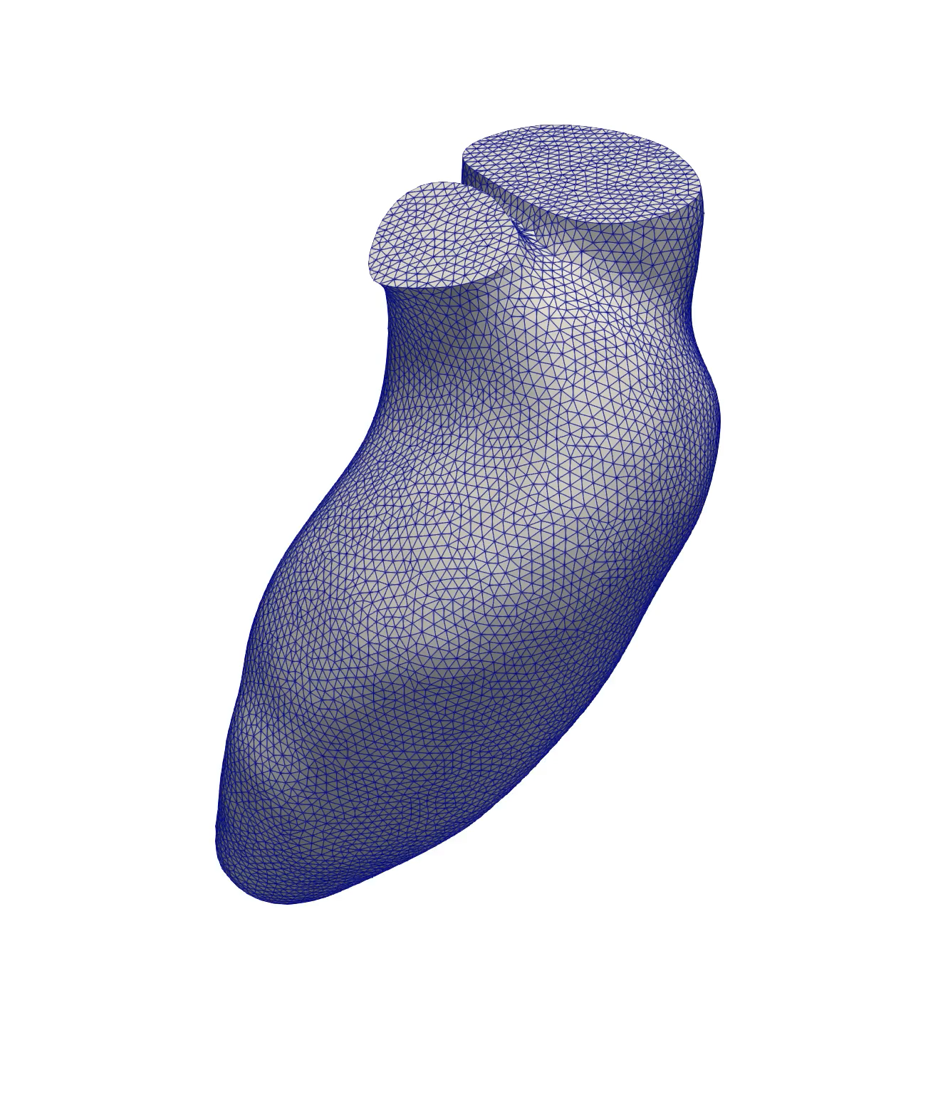
Ideal
Patient Specific
ModelFLOWs
Cardiac

Slide 15


Any questions?
Look us up in our website:
https://modelflows.github.io/modelflowsapp/cardiacpathologydetection/
ModelFLOWs
Cardiac

